Slide 1
Pattern research in Palmer Penguins Dataset
Palmer Penguins project working in R
Presented by David (Vigne) Ruiz Diaz

Slide 2
Summarize
This presentation centers on the research conducted using the Palmer Penguins dataset available in the R library, aiming to identify patterns relating to body mass and flipper length.
We will analyze the species and sex of the animals to gain further insights into whether these patterns are exclusive to particular conditions.

Slide 3

Tools and Libraries
The study was made using the following packages, libraries and tools:
R studio
Palmer Penguins package
Tidyverse package
Tidyr, GGPlot2

Slide 4
Research Focus
Why
Identifying trends or correlations between body mass and flipper length in penguins facilitates the detection of abnormal cases and enables more efficient intervention, if necessary, within the population of these animals.
How
We attach great importance to confirming any observed tendencies as specific to particular species or sex characteristics, striving to minimize bias in our analysis. Leveraging the data available in the R library, we conducted thorough exploration and comparison of various characteristics to uncover pertinent insights on the subject matter.

Slide 5
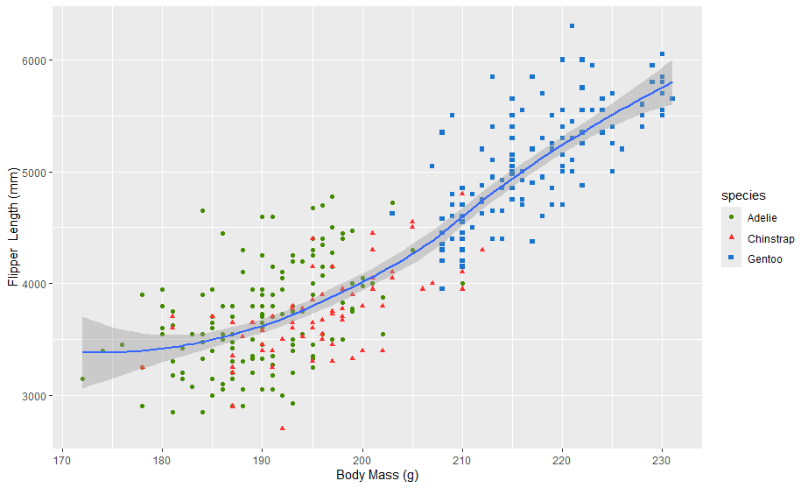
First Impressions
At first glance we saw two important factors:
High connection between Body Mass and Flipper Length
Relevance in species type

Slide 6
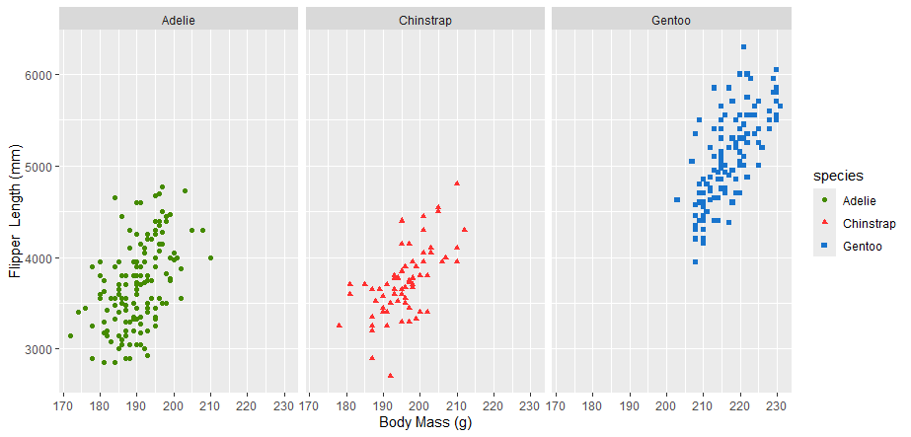
Species Analysis
Once identified a clear pattern and importance of species. It is time to check them individually

Slide 7
Avoiding Bias
Once arrived to this point we may start concluding that there’s an important connection between body mass of palmer penguins and their flipper lengths, but we said we would further investigate in order to avoid falling into bias of our own research.
The results were outstanding.

Slide 8
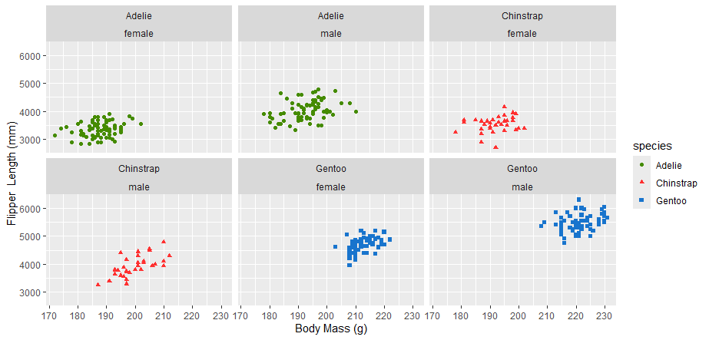
Sex Analysis
Sex happened to have more influence than expected
Adelie species did not present a relation between body mass and flipper length as it was expected. The results were given due to sex differences.
Chinstrap females does not present a significant correlation.
Male Chinstraps & Gentoo (both sex) present a slightly more influential relation between the characteristics but none in a conclusive stand.

Slide 9
Conclusion
Thanks to our pursuit of reliable information, we have determined that, based on the current data available, we cannot definitively establish a correlation between body mass and flipper length.
Further research incorporating additional data is necessary to make informed decisions. It is crucial to gather more data, particularly regarding male Chinstrap and Gentoo penguins, as these species show the highest potential for correlation in the context presented.

Slide 10
Questions?
Presented by David (Vigne) Ruiz Diaz

Slide 11
Thanks
Presented by David (Vigne) Ruiz Diaz

